Slide 1
INSPETTO
Presented by Team 7

Slide 2
Pre literature Conclusion
Previous systems depend only on visual surveillance.
Lack of chip-based verification makes forgery undetectable.
"The rising cases of license plate forgery and vehicle identity fraud expose critical gaps in current surveillance systems. There is an urgent need for real-time solutions that can accurately detect tampering and misplacing of License Plates.

Slide 3
Problem Statement
"Design a solution to identify vehicles with tampered, hidden, or illegal number plates using image recognition."
Challenges:
Number plate swaps.
Plate duplication.
Mismatches with registered vehicle data.

Slide 4
Proposed solution
Solution Name: INSPETTO
Key Idea: Match OCR[Optical Character Recognition] -detected license plates with LoRa [Long Range]-transmitted chip data.
Brief Tech Stack: Python (OCR), Django, LoRa, MySQL, HTML/CSS/JS.

Slide 5
Technical Novelty
Traditional systems rely only on visual data (ANPR[Automatic Number Plate Recognition]/OCR).
INSPETTO adds a second layer of validation by matching:
License plate extracted using Tesseract OCR from images.
Vehicle data (plate no., chassis no., ID) from LoRa-embedded chips.
Detects plate tampering, relocation, and forgery in real time.
LoRa enables data transfer with minimal power.
Ideal for city-wide or highway surveillance networks.
Works passively and securely, reducing interference and cost.
Built with Django + REST APIs for scalable backend processing.

Slide 6
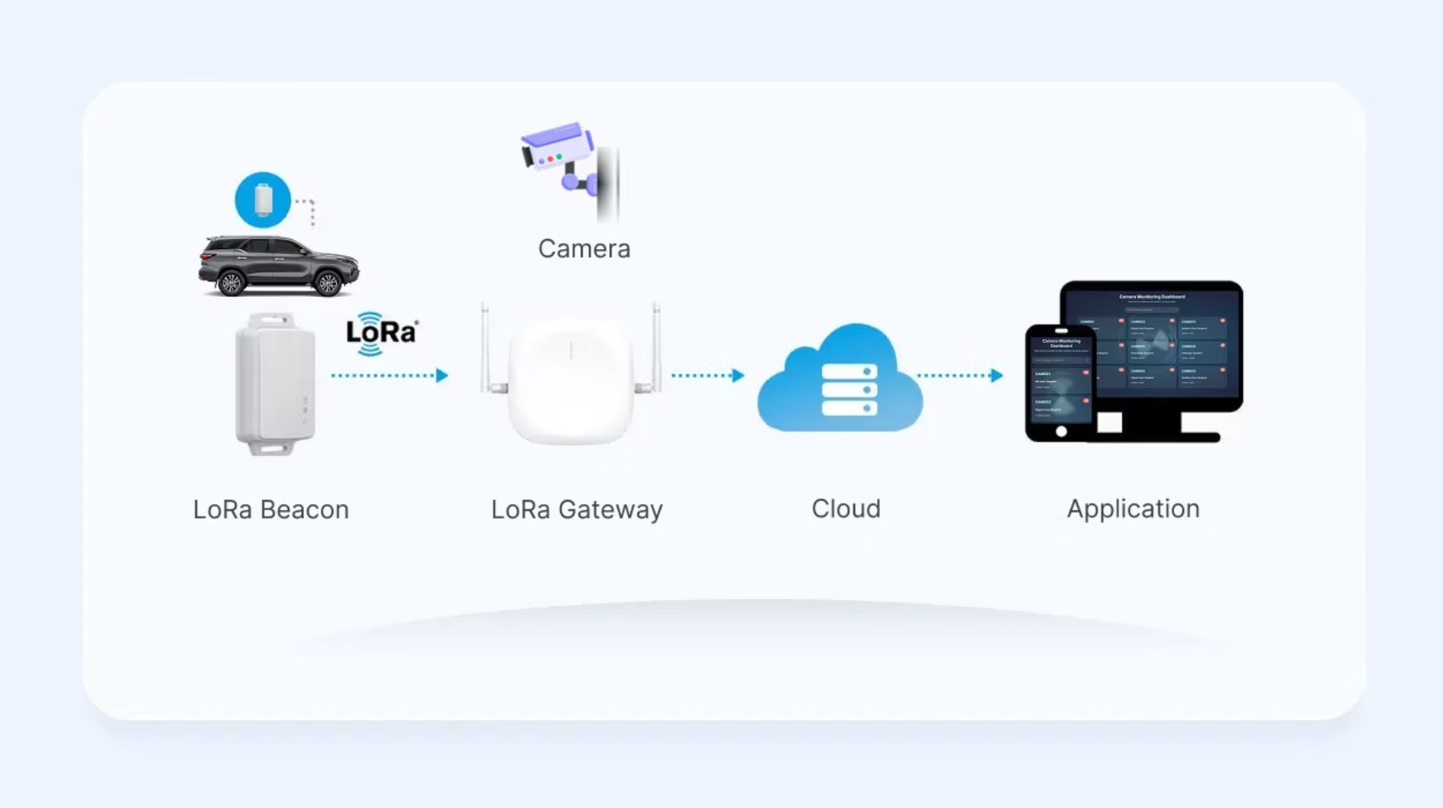
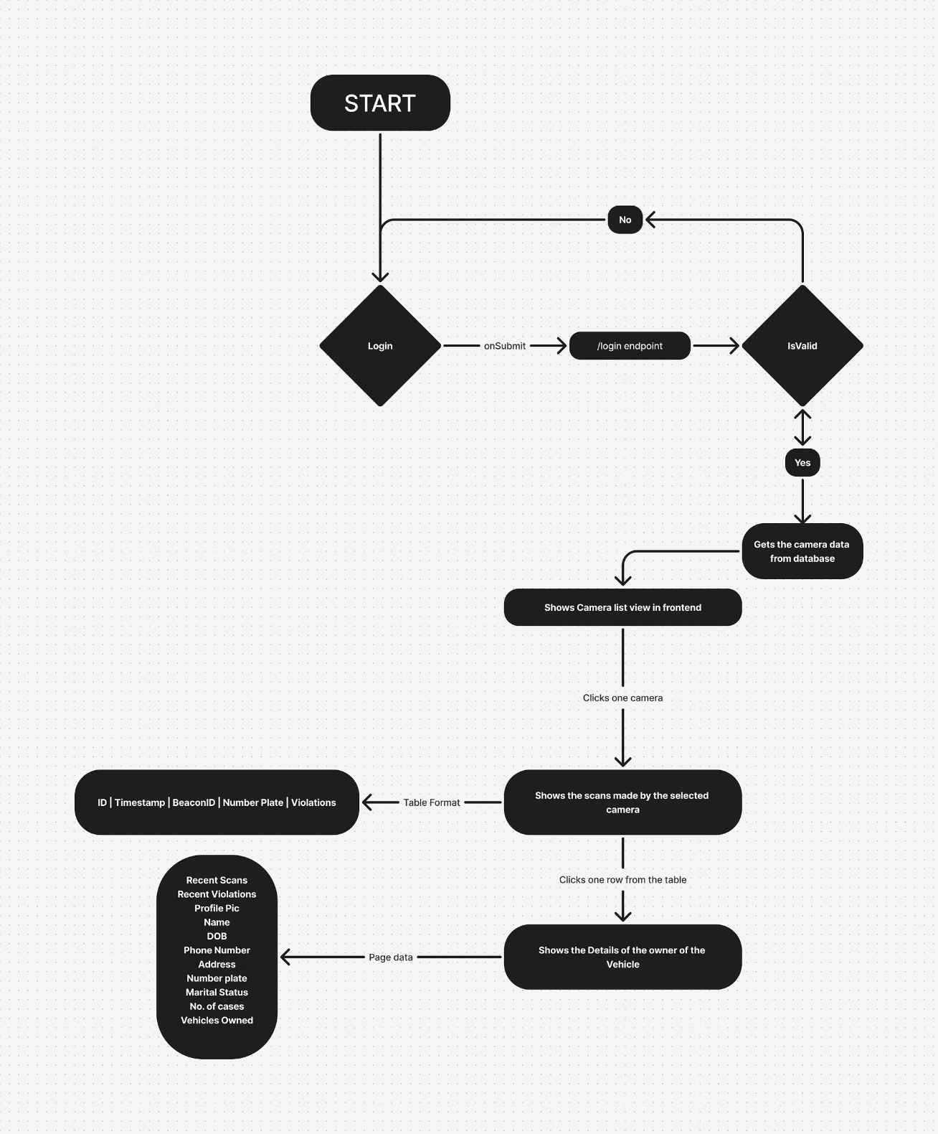
Process / Data / Work / Interface Flow Diagram

Slide 7
Feasibility of Solution
Technical Feasibility
Uses mature technologies: OCR (Tesseract), LoRa, Django, REST APIs.
Components are cost-effective and scalable.
Can be piloted in select zones (e.g., toll booths, urban hotspots) before full-scale deployment.
Economic Feasibility
Low setup cost per unit (LoRa chip & receiver, camera, basic hosting).
Government departments can deploy through public safety or smart city budgets.
Long-term return via:
Reduced manpower for manual checks.
Automated fine systems.
Accurate tracking of fraud.

Slide 8
3. Impact on Stakeholders
Common Man (Vehicle Owner)
Benefit: Safer roads, less exposure to cloned or illegal vehicles.
Assurance: Their vehicle identity is protected and verifiable.
No disruption: LoRa chip is passive, requires no user input.
Traffic and Law Enforcement Officials
Benefit: Real-time alerts for suspicious vehicles.
Efficiency: No need to manually compare plate numbers and documents.
Credibility: Tamper-proof digital data enhances evidence in legal cases.
Government/Transport Department
Benefit: Centralized, automated data on vehicle violations and compliance.
Ease of integration: Works with existing vehicle databases.
Revenue assurance: Reduced insurance, PUC, and registration fraud.

Slide 9
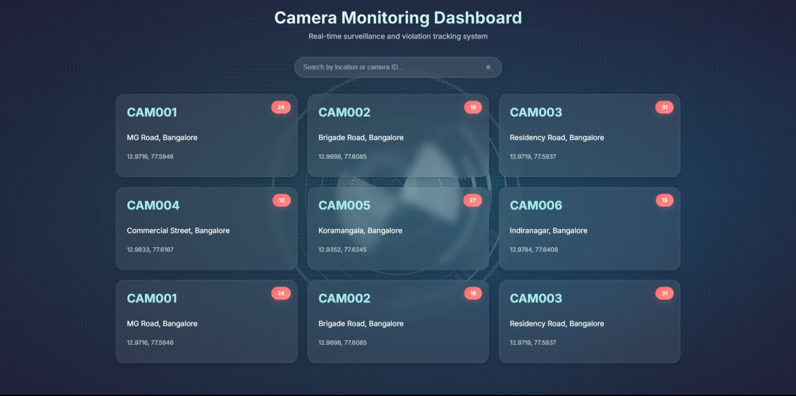
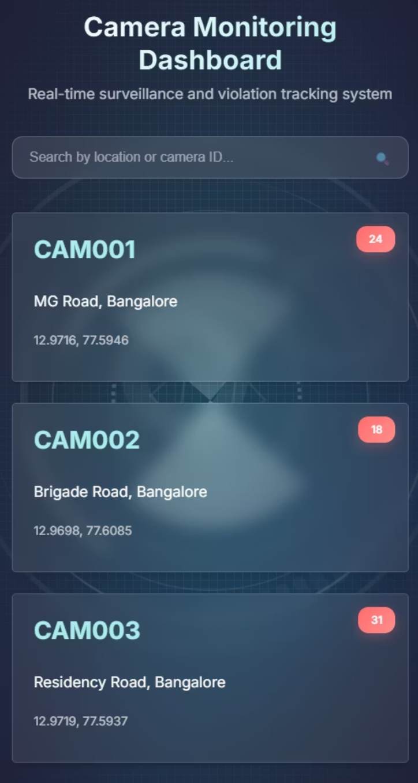
Layout of Web/Mobile/Product
MOBILE LAYOUT
WEB LAYOUT

Slide 10
Advantages of Proposed Solution
Detects plate tampering in real-time.
Cross-verification via embedded chip increases accuracy.
Scalable, adaptable to existing smart city infra.

Slide 11
Financial Aspect When Commercialized
Initial Development Cost
Component
Estimated Cost (INR)
OCR & Backend Development
25,000 – 40,000
LoRa Chip + Receiver per unit
300 – 500
Camera Module (per location)
2,500 – 4,000
Cloud/Server Hosting (per year)
8,000 – 15,000
Initial investment :₹35,800 – ₹59,500 (for 1–2 camera zones with LoRa receivers)

Slide 12
Annual Operational Costs
Item
Estimated Range (INR)
Server Maintenance & Updates
10,000 – 15,000
LoRa Chip Provisioning (per vehicle)
100 per vehicle
Camera Calibration & Power
Minimal (solar optional)
Operational Cost (excluding chip volume): ₹10,000 – ₹15,000/year
Total Estimated Year-1 Investment
Cost Type
Value (INR)
Initial Setup
₹35,800 – ₹59,500
First Year Operations
₹10,000 – ₹15,000
Total (Year 1): ₹45,800 – ₹74,500

Slide 13
Real World Impact
Safety: Helps law enforcement track actual offenders.
Security: Reduces fake plate crimes and vehicle fraud.
Scalability: Can be expanded to toll booths, border checks, etc.
Smart City Integration: Syncs with traffic management and surveillance systems.

Slide 14
THANK YOU
For your time and attention.

